Slide 1
Real-world Social Networking for Gov 2.0
Delivering an integrated solution for a diverse government
Dean Halstead
Collaboration Architect
Microsoft Federal
deanh@microsoft.com
http://twitter.com/deanhalstead (@DeanHalstead)
Notes:
Focus on how to bring Gov 2.0 to your internal network and how to integrate that internal deployment with external

Slide 2
Agenda
Common Challenges
Sample solutions
Gov 2.0 Kit Demo
Resources

Slide 3
Common Challenges
Internal Micro-blogging (Twitter ™/Facebook™)
Communities
Social Network Analysis
Geospatial Integration
Podcasting
Governance
Security Concerns
Integration and Interoperability
Information Spillage
Silos of Information
On-premise hosting
Identity Management

Slide 4
Common Challenges
Internal Micro-blogging (Twitter ™/Facebook™)
Communities
Social Network Analysis
Geospatial Integration
Podcasting
Governance
Security Concerns
Integration and Interoperability
Information Spillage
Silos of Information
On-premise hosting
Identity Management
Notes:
Main Focus of session is highlighted.
Ones that are non highlighted are an agency by agency approach. I can be contacted to understand how other agencies are approaching this other difficult issues.

Slide 5













SharePoint 2007
Legend
Gov 2.0 features
Social Networking Features
Server-based Excel spreadsheets and data visualization, Report Center, BI Web Parts, KPIs/Dashboards
Docs/tasks/calendars, blogs, wikis, e-mail integration,
offline docs/lists, real-time collaboration, picture library, unified messaging, audio/video/web conferencing
All SharePoint BI Plus:
Balanced Scorecard, Drill-down, Problem Identification, Advanced BI
PerformancePoint
Server
Business
Intelligence
Collaboration
Platform
Services
RSS, Workspaces, Mgmt,
Security, Storage,
Topology, Site Model
Enterprise Portal template, Site Directory, My Sites, social networking, privacy control
Rich and Web forms based front-ends, LOB actions, enterprise SSO
Business
Forms
Portal
Content
Management
Search
FAST for
SharePoint
Integrated document management, records management, and Web content management with policies and workflow
Enterprise scalability,
contextual relevance, rich
people and business
data search
All SharePoint Search Plus:
Role-based Search, Pipeline, metadata extraction, ultimate scale, adv visuals
Notes:
Items in Gov 2.0 in Blue
Social Networking in Green

Slide 6
Out-of-the-Box Gov 2.0* capabilities
Technology | Simple Definition | SharePoint Suite | Microsoft Products
Blogs | Journal or diary with social collaboration (comments) | Standard | SharePoint Server. Word ships with a Blog "post" template
Wikis | Collaborative authoring &editing | Standard | SharePoint Server
Video Sharing & Multimedia | Videos, images and audio libraries (YouTube, Soapbox…) | Standard w/ IMM ESP for SharePoint | Interactive Media Manager for SharePoint Server or Podcast Kit for SharePoint Server (FREE Download)
Photo-Sharing | Photo Libraries | Standard | SharePoint Server
Podcasting | Multimedia content syndicated out for use on MP3 players | Standard | Podcast Kit for SharePoint Server (FREE Download)
Virtual Worlds | Simulation of environments and people (Second Life) | N/A | Microsoft Enterprise Simulation Platform- Xbox 360
Social Networking Sites | Connecting people globally | Standard | SharePoint Server People and Expertise
Syndicated web Feeds (RSS) | Automated notifications of frequently updated content (RSS) | Standard | SharePoint Server (Search and all Lists)
Mashups | Combine content from multiple sources from an integrated experience | Core Windows JackBe | SharePoint Server provides web parts for visualization of data from the Business Data Catalog connector, XML Mashup, Visual Studio, SharePoint Designer
Widgets, Gadgets, Pipes | Small applications and code in Web pages or for desktop use | Standard | SharePoint Server Web Parts, Windows Live Gadgets
Social Bookmark and News (Sharing, Tagging) Sites | Ways of sharing content with others | Standard | SharePoint Server with Community Kit (Free Download)
Micro-blogging, Presence Networks | Form of blogging which allows brief (Instant Message size) text updates | Standard OCS | Gov 2.0 Kit Office Communications Server R2
Gov 2.0 Data Mining and Aggregation New! | Making sense of all the data. Allow responsiveness, trend analysis, and the ability to deliver targeted information | Enterprise | FAST ESP Search for Office SharePoint Server 2007, Office PerformancePoint Server 2007, Social Streams, and Entity Extraction, and Microsoft Vine
*All capabilities can be exposed for Internet use and derived from USA.gov
http://www.usa.gov/webcontent/documents/SocialMediaFed%20Govt_BarriersPotentialSolutions.pdf
Notes:
Mapping of Gov 2.0 technologies to SharePoint and Office System Solutions.

Slide 7
Sample Solutions

Slide 8
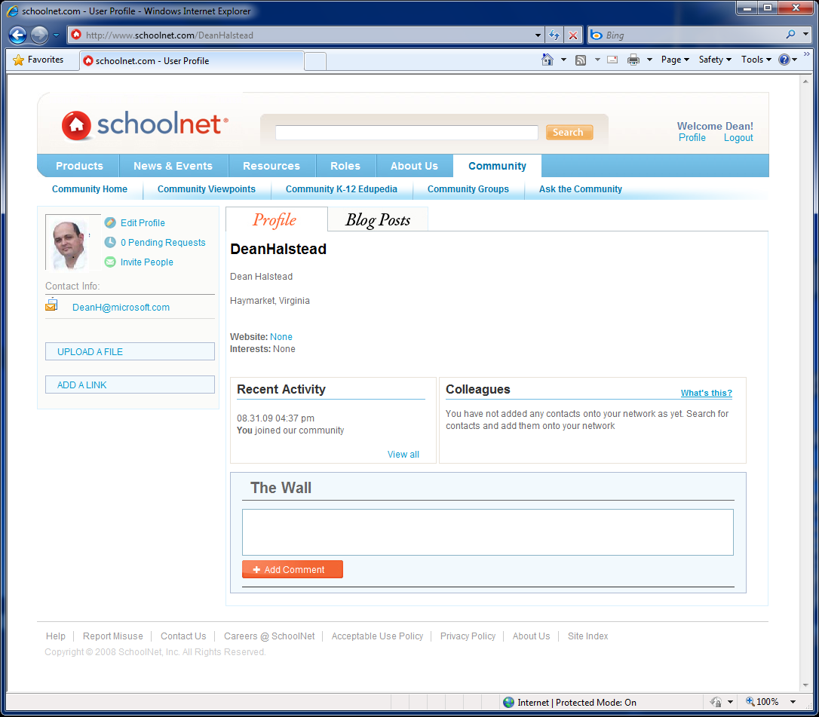
Notes:
Great on-line “test drive” of how SharePoint can support Social Networking
-Blogs
-Friends
-Walls
Available for “test drive” on the Internet (URL at end of deck)

Slide 9
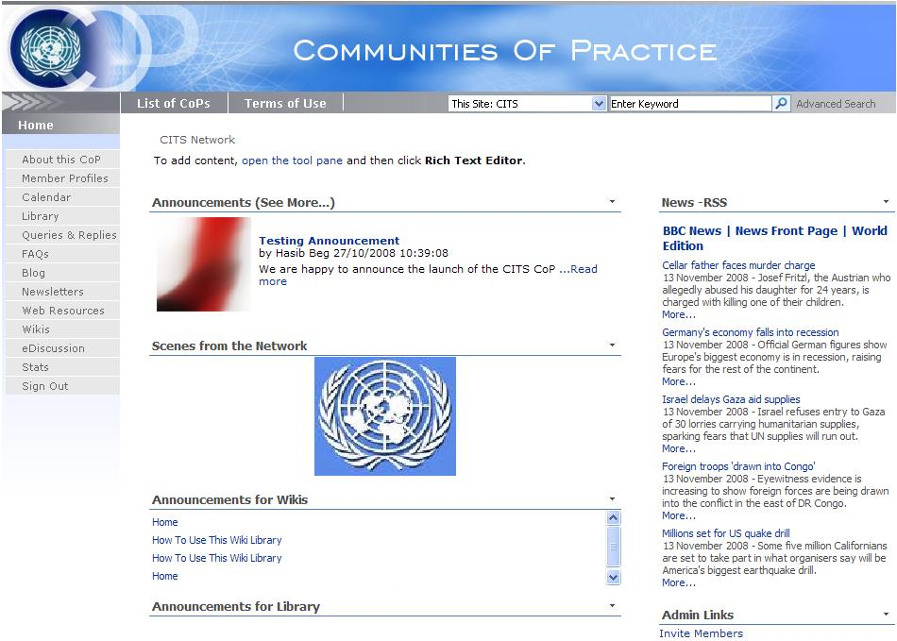
Notes:
Great example of how you can create communities of interest and practice in SharePoint
Story - Most Creative Example is Army Materiel Command for logistics
(INTERNAL Site and not available on Internet)

Slide 10
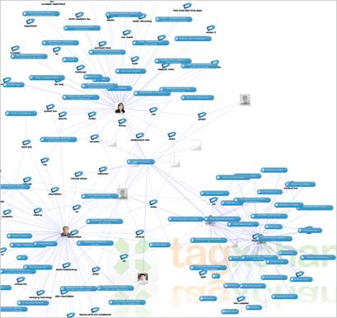
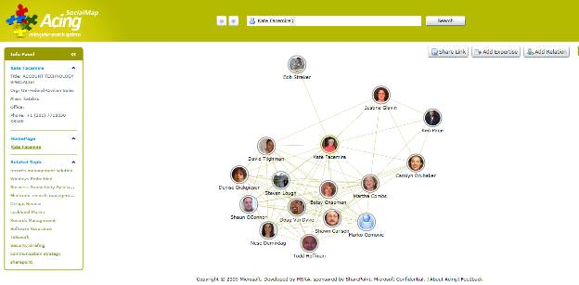
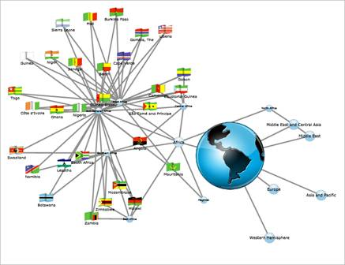
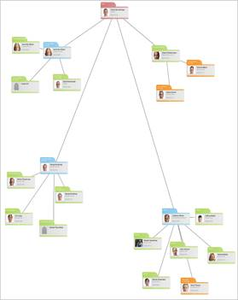
IMF ICE Project
Notes:
Trying to get higher resolution screen shots
Talk about Social Networking Analysis
Published to Codeplex this week
Story about how IMF or other agencies are using

Slide 11
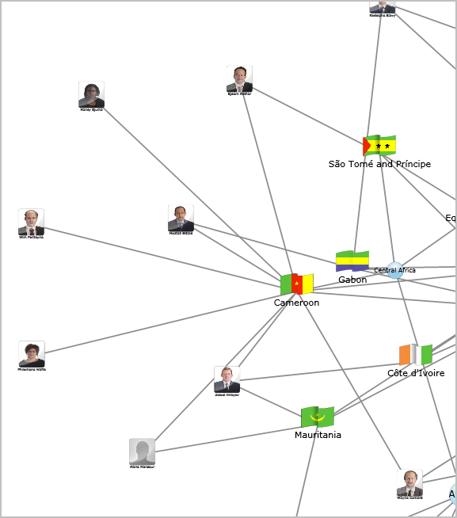
Expertise by Country
Watch Open Source Solution

Slide 12
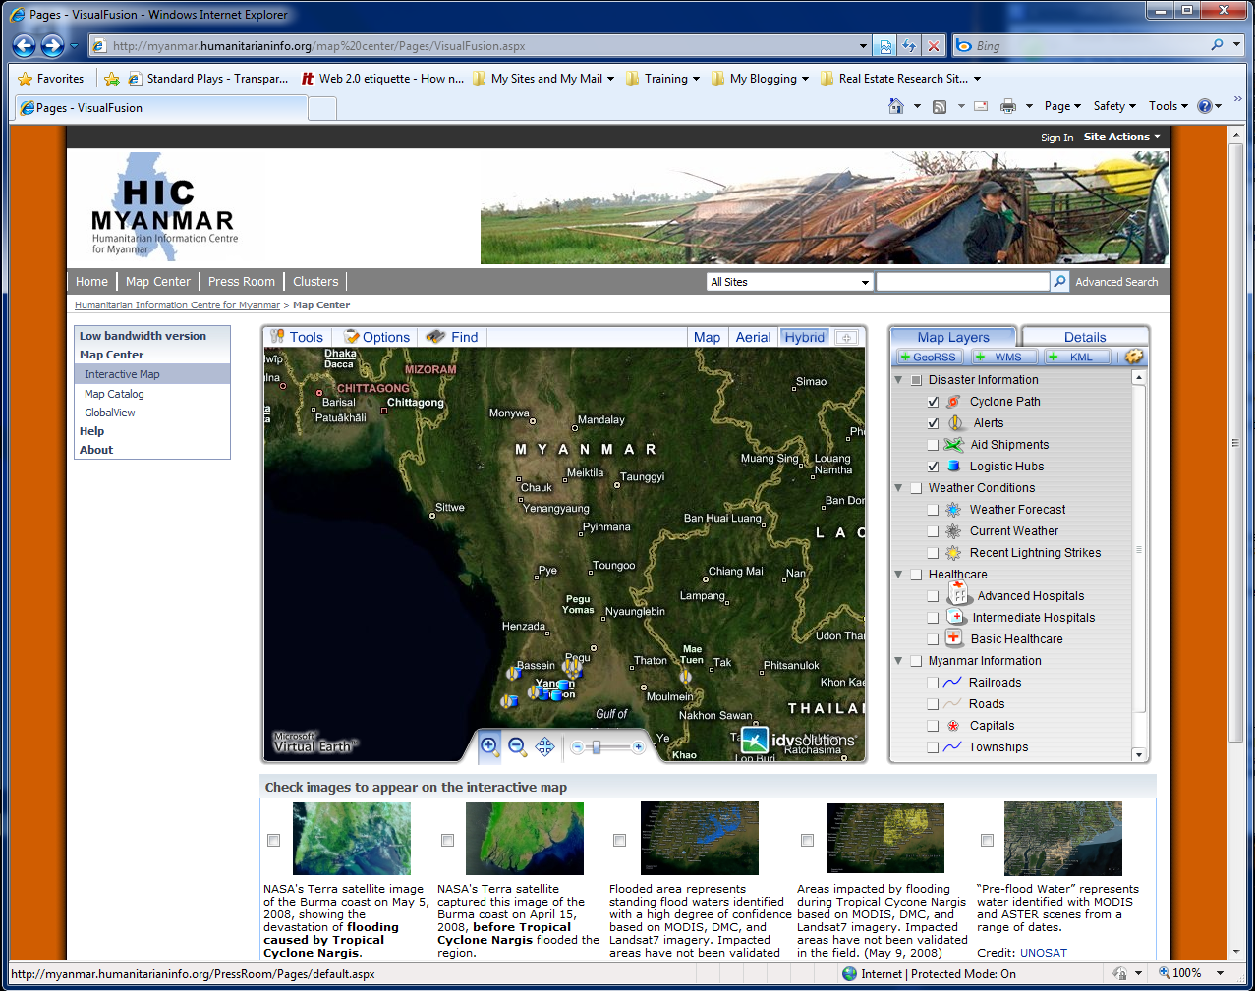
Notes:
Talk social networking data or unstructured search results and plot them
Microsoft’s Search can provide hot topics
Story – Emergency at bridge via Twitter
Available for “test drive” on the Internet (URL at end of deck)

Slide 13
Gov 2.0 Kit

Slide 14
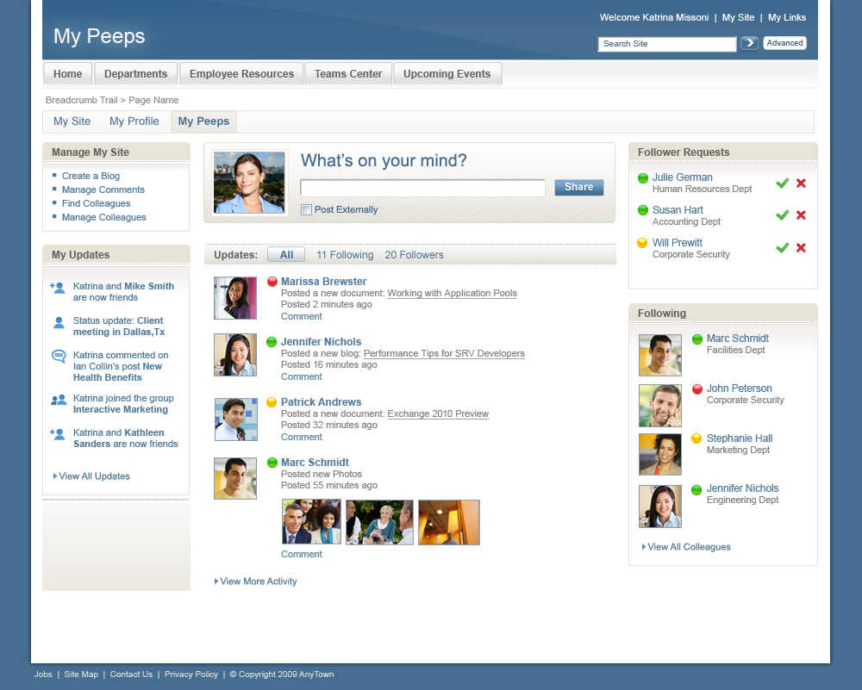
Notes:
Bring Social Networking – Micro-blogging
Designed for government – Optional integration with Twitter and Facebook
Open Source solution built on SharePoint to be released approximately Sept 30th to http://www.codeplex.com

Slide 15
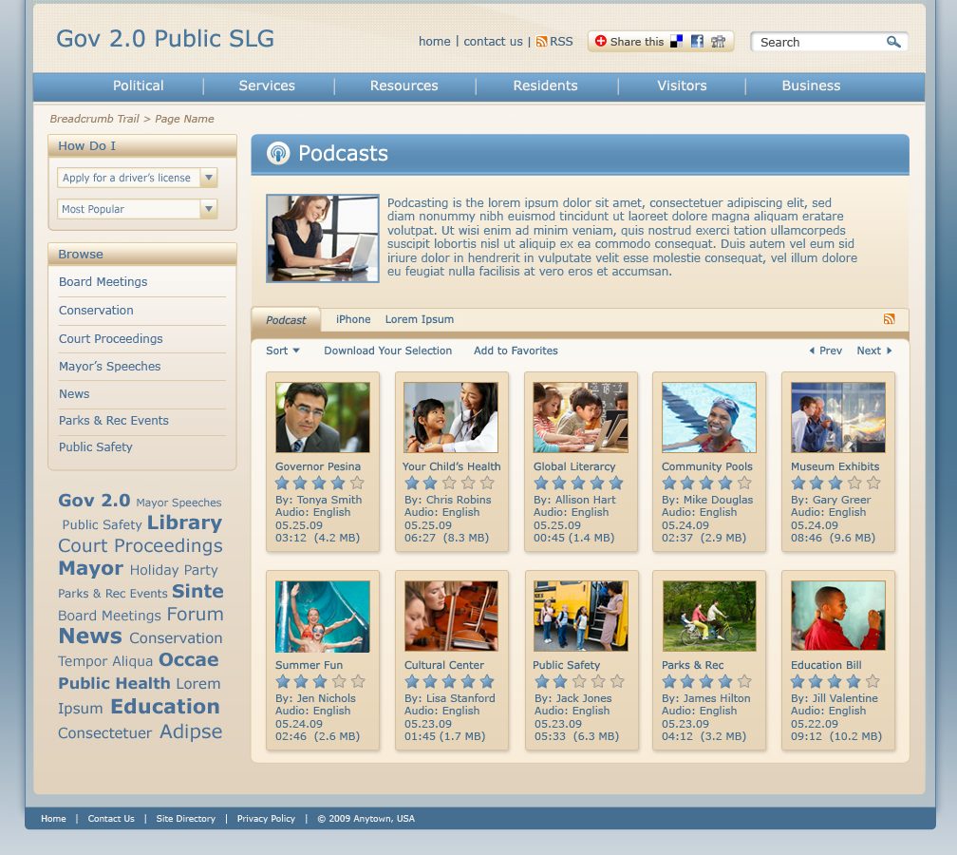

Slide 16
Resources
Gov 2.0 Getting Started
  http://tinyurl.com/Gov2GetStarted
The Way to Gov 2.0
  http://tinyurl.com/WaytoGov2
Gov 2.0 Plan
  http://tinyurl.com/Gov2PlanTemplate
Gov 2.0 Checklist
  http://tinyurl.com/Gov2Checklist
Free Gov 2.0 Add-ons
  http://tinyurl.com/MSGov2Addons
Social Networking Overview
  http://tinyurl.com/SocialNetworkDemo
Office 2010 Sneak Peak
  http://tinyurl.com/Office2010Peak
On-Line Samples
United Nations - HIC
  http://tinyurl.com/UNHICMap
  http://tinyurl.com/UNHICCommunity
Schoolnet
  http://www.schoolnet.com/
Top 100 Sites
  http://tinyurl.com/SharePointTopSites
ICE on CodePlex
  http://tinyurl.com/ICEonCodePlex

Slide 17

© 2006 Microsoft Corporation. All rights reserved.
This presentation is for informational purposes only. Microsoft makes no warranties, express or implied, in this summary.

